Slide 1
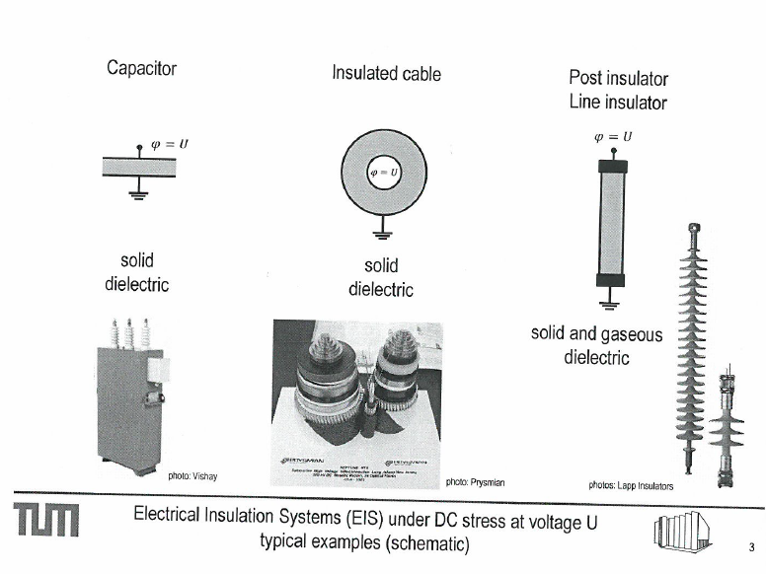
Common electrode geometries in HV equipment

Slide 2
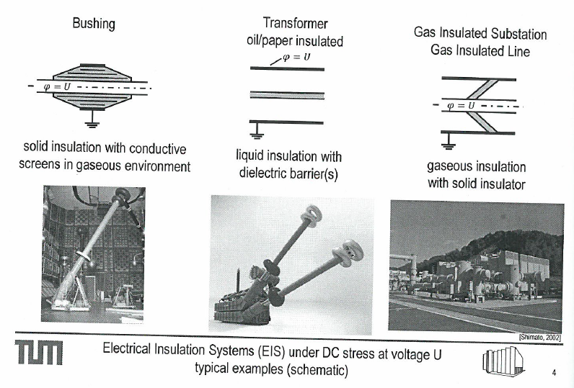

Slide 3
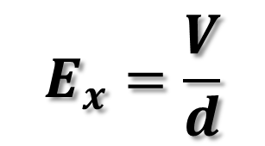
E-field between parallel plate electrodes
x
d
V
E
$$E_{x}=\frac{V}{d}$$
Inside the dielectric
x
Inside inner electrode
Inside outer electrode

Slide 4
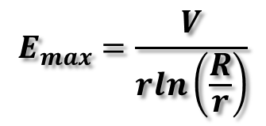
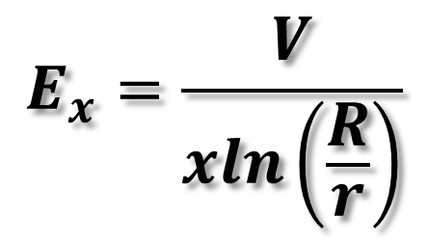
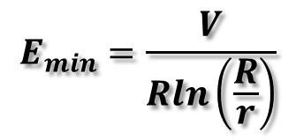
E-field between coaxial electrodes
x
R
r
$$E_{max}=\frac{V}{rln\left(\frac{R}{r}\right)}$$
$$E_{x}=\frac{V}{xln\left(\frac{R}{r}\right)}$$
E
$$E_{min}=\frac{V}{Rln\left(\frac{R}{r}\right)}$$
x
Inside inner electrode
Inside outer electrode

Slide 5
Practice question
Determine the overall diameter of a single-core cable and its most economical core diameter when working on a three-phase, 275 kV system. The maximum permissible stress in the dielectric (insulation) is not to exceed 15 kV/mm.
Ans: Core diameter = 2r = 29.92 mm
Economical inner diameter of the sheath = 81.32 mm

Slide 6
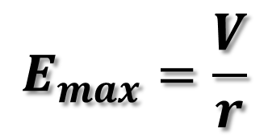
E-field around a spherical electrode
r
$$E_{max}=\frac{V}{r}$$
V
E
x
Inside inner electrode

Slide 7
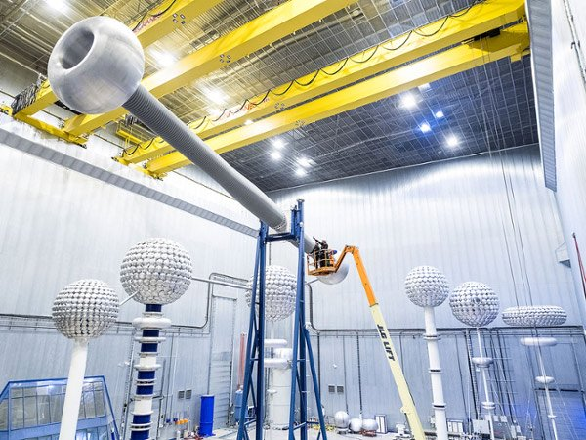
A 1100 kV bushing by ABB in China

Slide 8
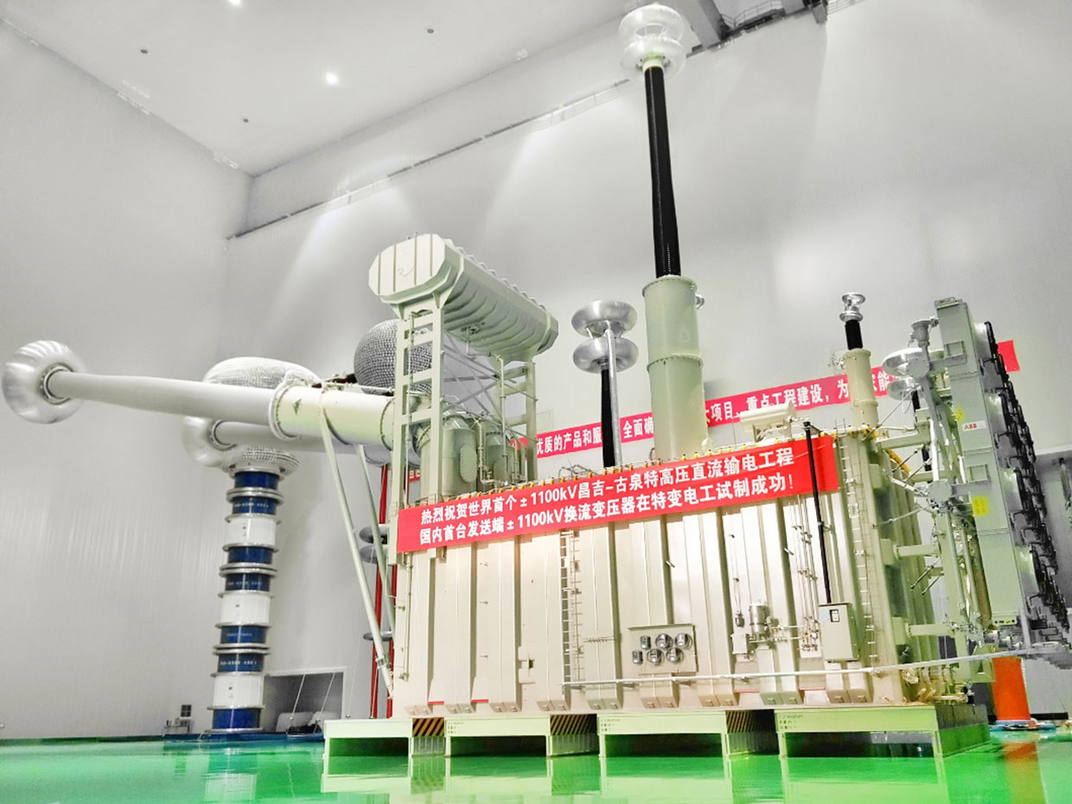
1100kV Power Transformer

Slide 9
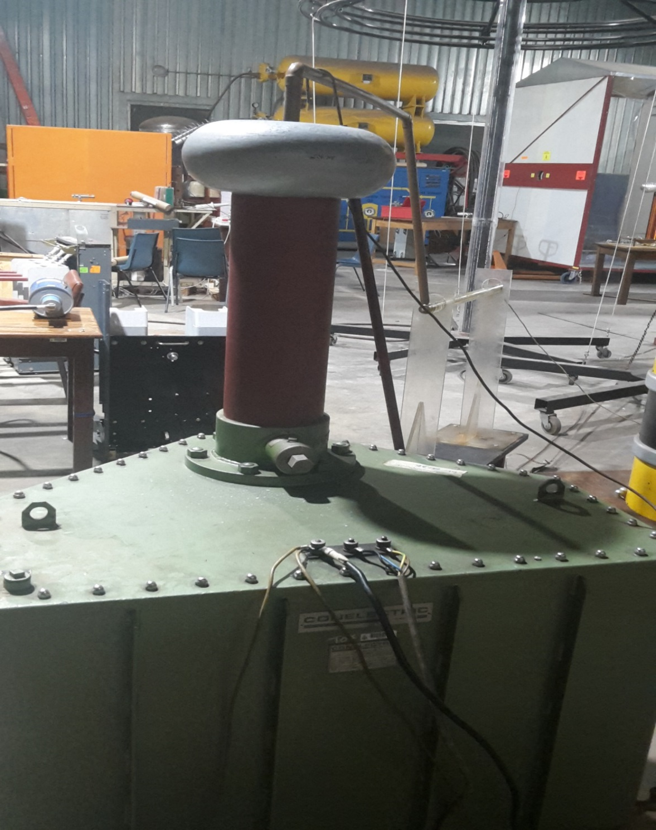
Practice question
Calculate the outer diameter of a corona ring that needs to be installed on the terminal end of a single phase test transformer bushing to prevent corona inception at a maximum voltage of 150 kVrms. Assume standard atmospheric conditions where air ionises at 3 kV/mm
Ans: Outer diameter ≥142 mm

Slide 10
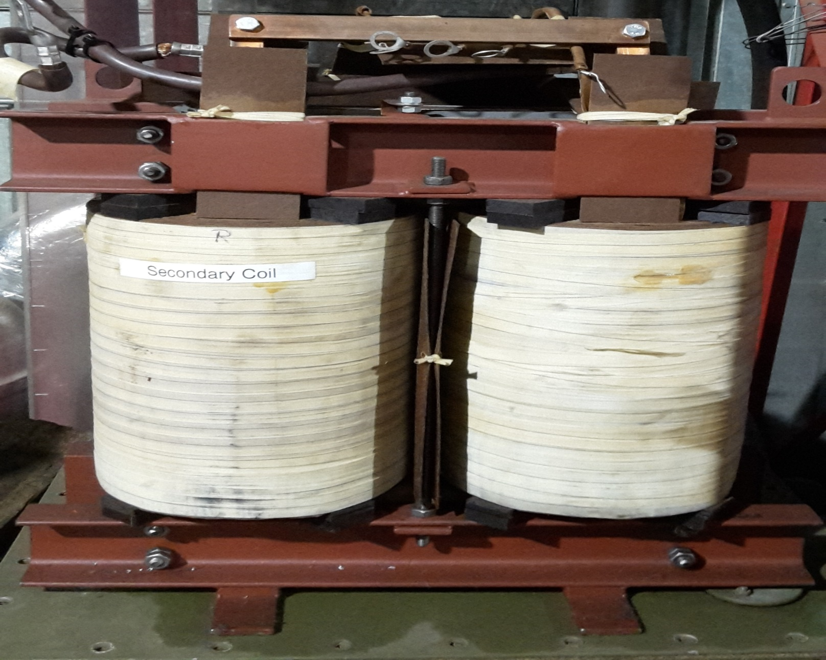

Slide 11
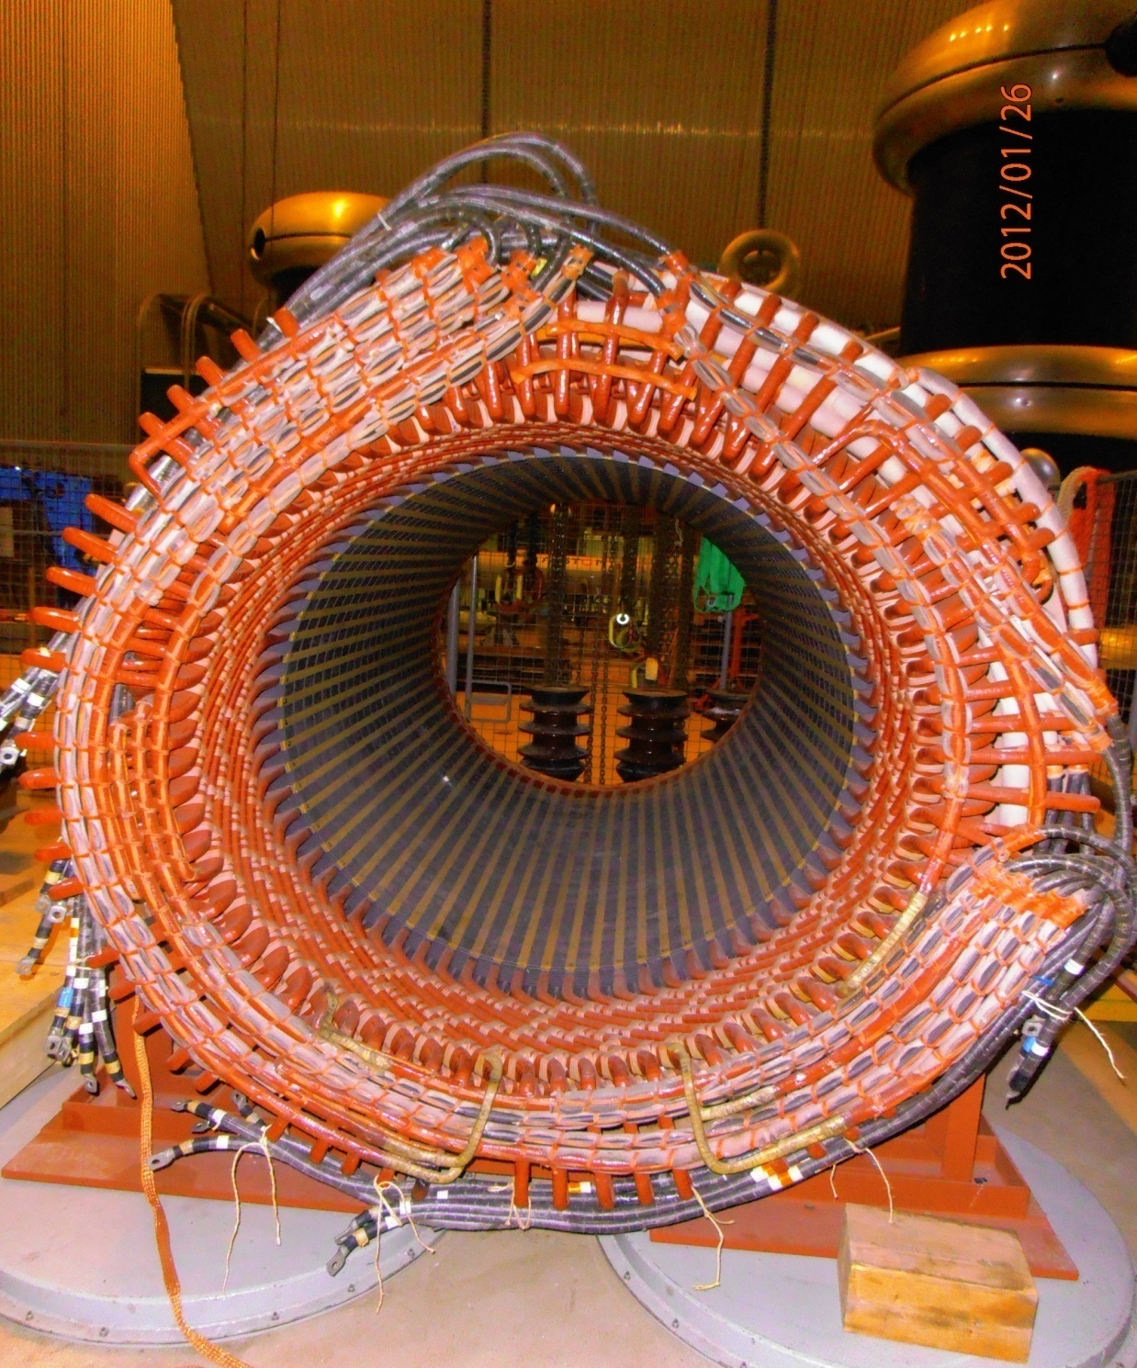

Slide 12
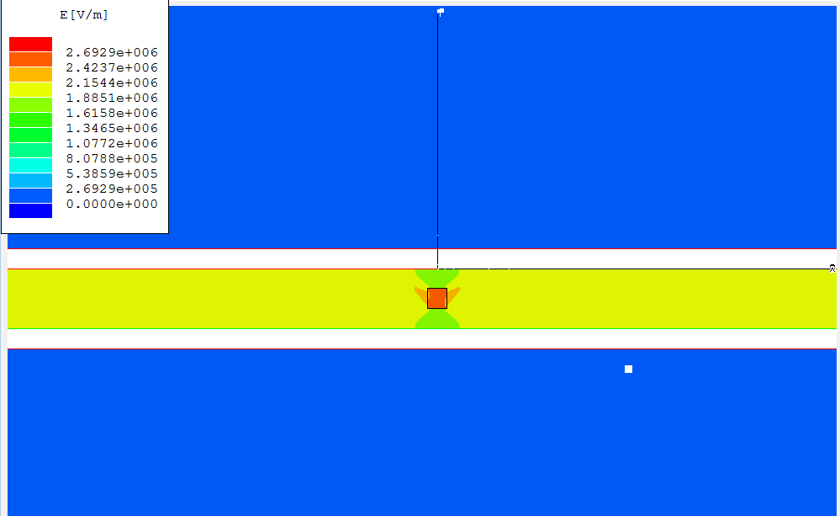

Slide 13
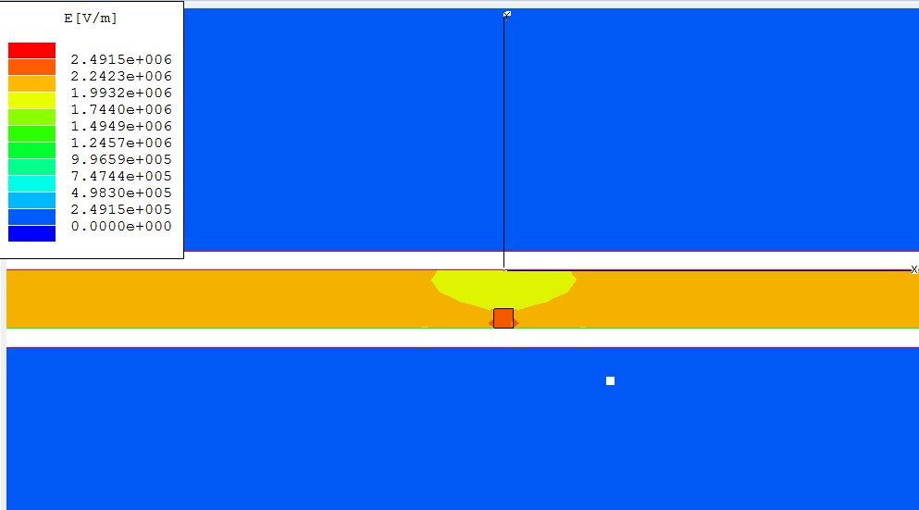

Slide 14
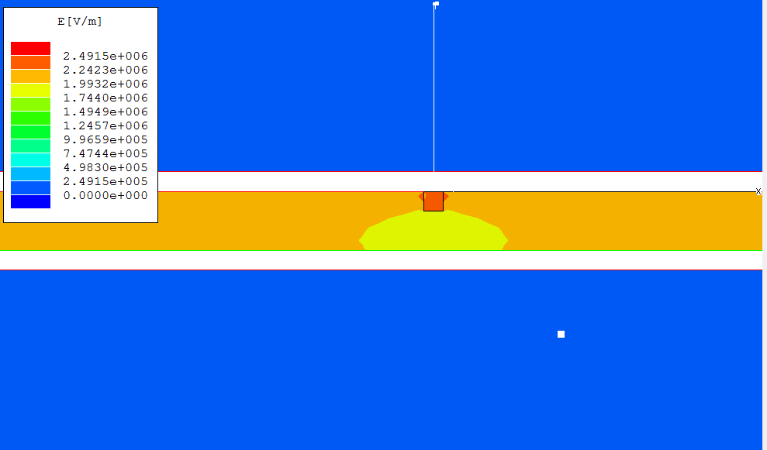

Slide 15
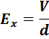
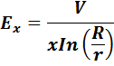
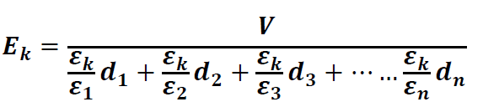
Field strength at distance x between the electrodes
PARALLEL PLATES | COAXIAL | SPHERES
In multilayered dielectrics
Parallel plate electrodes
Coaxial electrodes

Slide 16
Practice problem
An air cavity of 1 mm thickness is trapped between the insulation and the outer metallic shield in a power cable of 4 mm and 6 mm inner and outer conductor radii respectively. If the cable is single phase and rated 6 kV phase-ground,
a) Calculate the maximum electric field stress in the air cavity.
b) Plot and compare the electric field profile in that part of the cable;
(i) without the air cavity and (ii) with the air cavity present in the insulation. Comment on the effect of the air cavity on the field profile in that part of the cable.
c) What are the implications of the cavity on the insulation integrity?
d) If the air cavity is replaced by a piece of a metal of the same dimensions as the cavity, calculate the new maximum electric field values in the system. On the same axis with that of defect free cable, sketch the resultant new electric field of the electric field profile

Slide 17
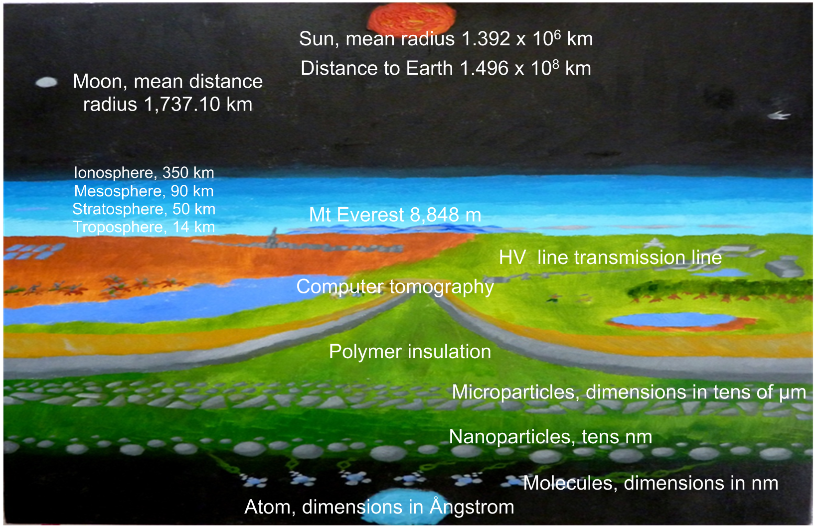

Slide 18
Types of charge carriers
Electrons | Ions | Large ions
Charge:
q_{e} = e⁻ with unit charge
e⁻ = 1.602 x 10⁻¹⁹C
Charge when singly ionised: q_{i} = ±e
Formation by attachment of electrons or ions on dust particles, water droplets (fog) or similar microscopic particles
Mass = approximately equal to molecular weight M times proton mass:
M_{i} = M.2826.M_{e}
Mass
M_{e} = 9.110 x 10⁻²⁸g

